Slide 1

An AdWords Ad Performance Analysis by R
Final project submission
By Simon Chen

Slide 2
Background and goal
AdWords, Google’s online advertising program.
Try to get basic AdWords Data by API and analyze an ad campaign with R.

Slide 3
Definition
Customer account
MCC(My Client Center) account
Clicks
Conversions

Slide 4
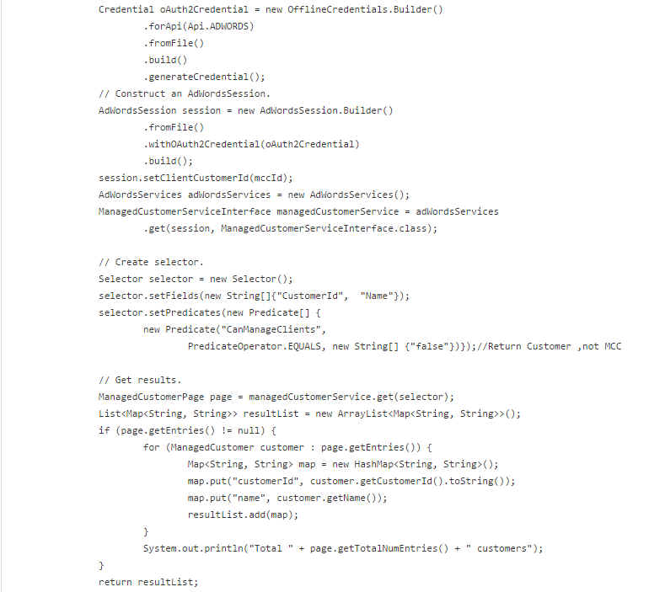
Data Preparation
A MCC’s data of customers by AdWords API
https://developers.google.com/adwords/api/docs/reference/v201406/ManagedCustomerService

Slide 5
Data Preparation
MCC’s daily data of all ad campaigns last month(2014/10) by AdWords API
https://developers.google.com/adwords/api/docs/appendix/reports#campaign
MCC’s daily data separated by countries last month(2014/10) by AdWords API
https://developers.google.com/adwords/api/docs/appendix/reports#geo

Slide 6
Data Preparation
Defined three MySQL tables to save the data above.

Slide 7
Data Preparation

Slide 8
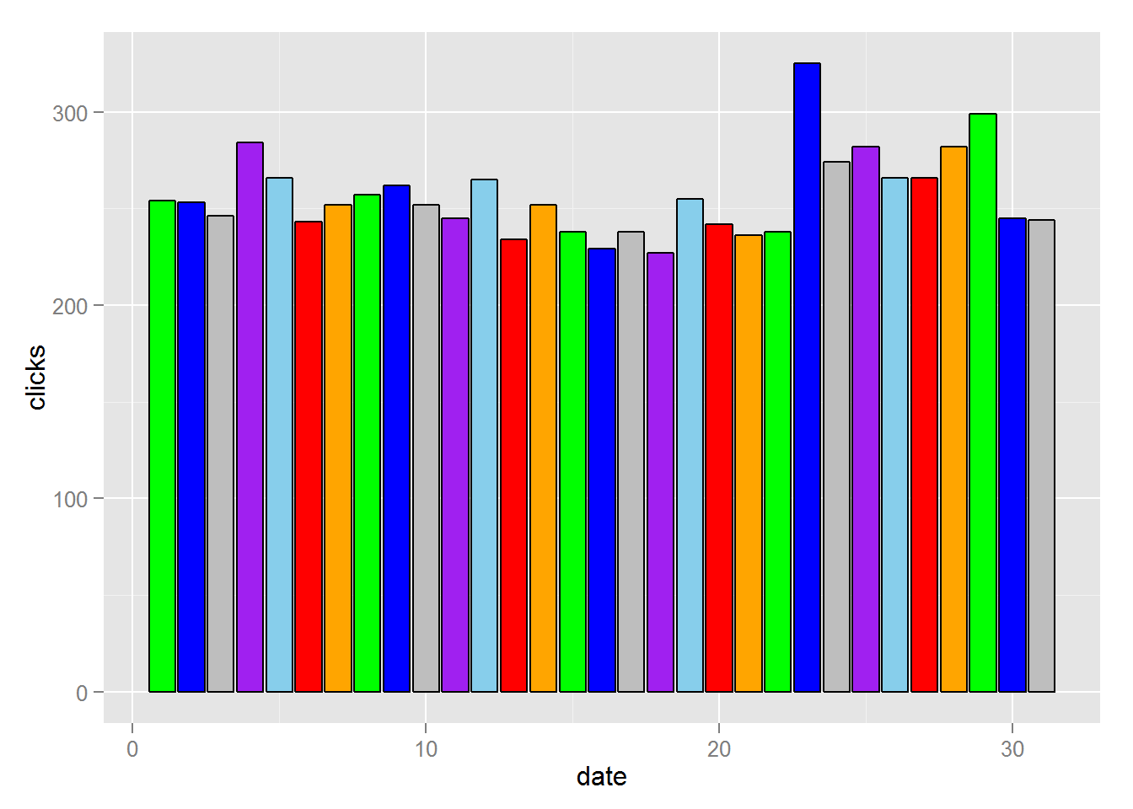
Scenario 1
I want to know the daily clicks of an ad campaign last month(2014/10).

Slide 9
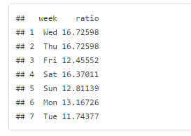
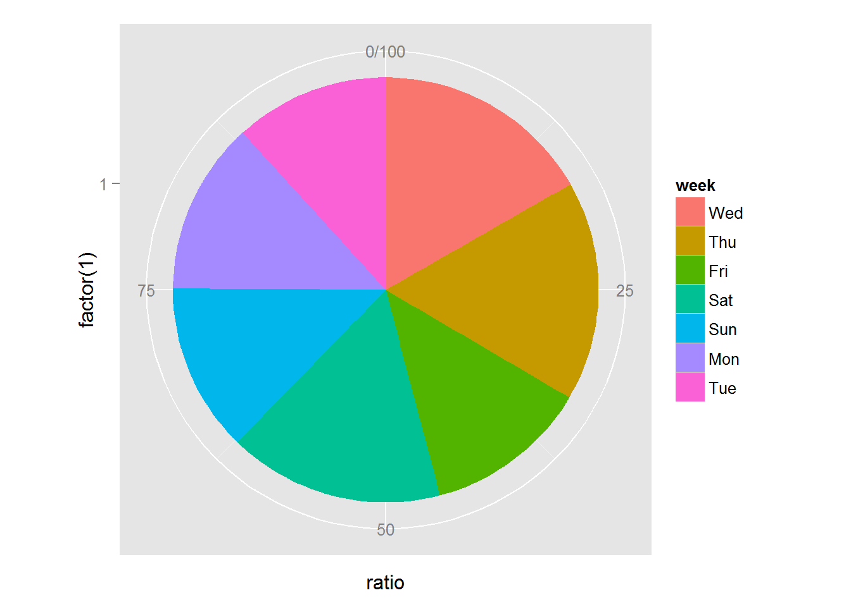
Scenario 2
I want to know conversions of every day of Weeks.

Slide 10
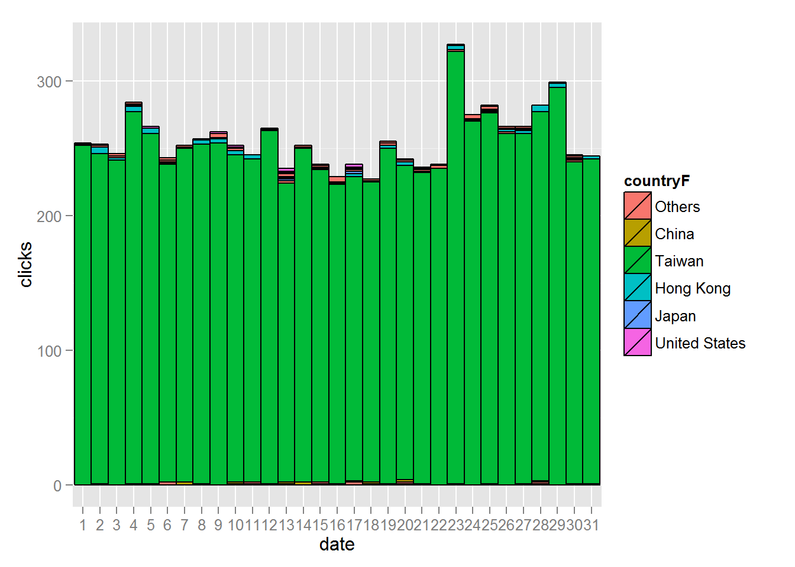
Scenario 3
I want to know clicks from every country.

Slide 11
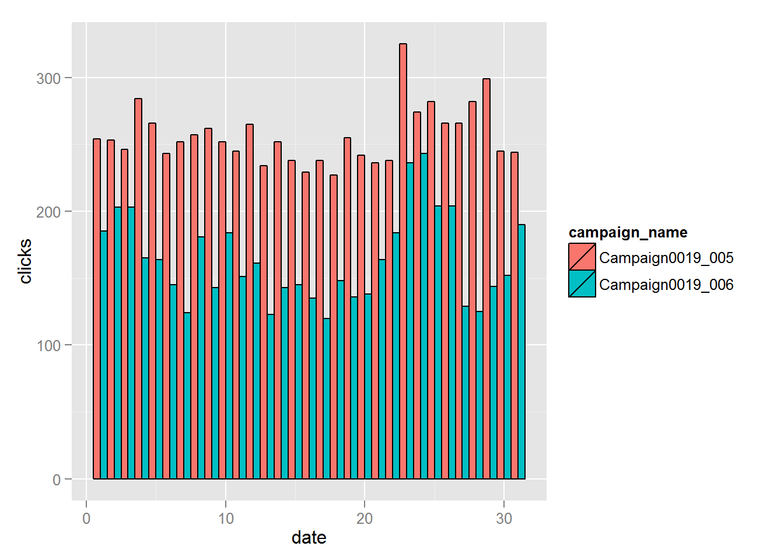
Scenario 4
I want to compare two similar ad campaigns.

Slide 12
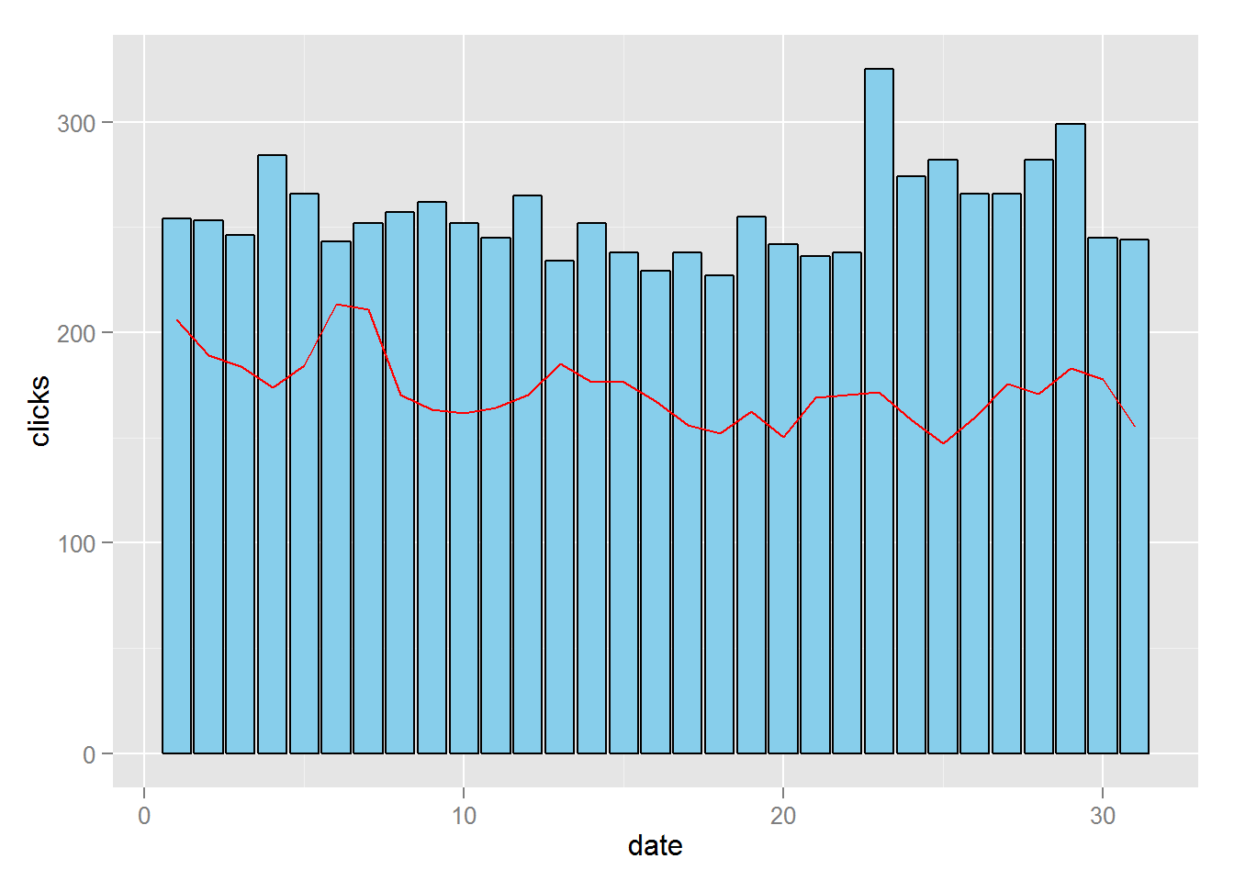
Scenario 5
I want to compare ad campaigns with the mean.

Slide 13
Conclusion
Virtualizing our AdWords performance data with R will help us understand the operation of ad campaigns more easily.

